Slide 1
Migration to Britain since c.400AD
www.ourmigrationstory.org.uk

Slide 2
Migration to Britain since c. 400AD
Lesson Objectives
Starter task
To identify points of origin and time of arrival of the different immigrant groups who have come to Britain since the Romans left in the 5th Century.
To identify changes and continuities in patterns and reasons for migration to Britain across different time periods.
Read the migration story about the Iron Bangle Lady in Roman Britain and find out:
When the Romans first conquered Britain
Where historians think the Iron Bangle Lady came from
The name of the Roman Emperor of African descent who came to Britain
www.ourmigrationstory.org.uk
Notes:
Starter task: this task assumes pupils have covered pre-1066 immigration to Britain, at least in outline.

Slide 3
Who came to Britain after the Romans?
Migration to Britain since c. 400AD
By the early 5th century the Romans had left Britain. In the 1600 years since the last Romans left in 410AD many groups have migrated here from all over the world and for many different reasons
What do you know about the people who came to Britain after the Romans?
Where do you think most migrants to Britain have come from?
www.ourmigrationstory.org.uk

Slide 4
Who came to Britain after the Romans?
Migration to Britain since c. 400AD
Your task in this lesson is to map the major migrations during four different periods of British history:
400-1500
1500-1750
1750-1900
1900-2010
and then to analyse changes and continuities in the pattern of migration.
www.ourmigrationstory.org.uk

Slide 5
Migration to Britain since c.400AD
Use the links below to view migrant stories from each of the time periods. Find out the following information about each group:
From where in the world they came to Britain
When they came
Why they came to Britain
c.400 – 1500 Angles, Saxons and Jutes Vikings Africans Jewish people | 1500 – 1750 Gypsies Flemish and Dutch Africans Huguenots Palatines
1750 – 1900 Formerly enslaved Lascars Irish Italians Indian ayahs | 1900 – 2010 Jewish people – pre-World War Two Chinese Polish people during and after World War Two Jewish people during World War Two Irish Caribbean people Asians – Pakistani & East African Polish people – 21st century
Notes:
Pupils highlight the towns mentioned in the timeline on the map on the left, or use an atlas to find and position the towns on the blank map themselves.

Slide 6
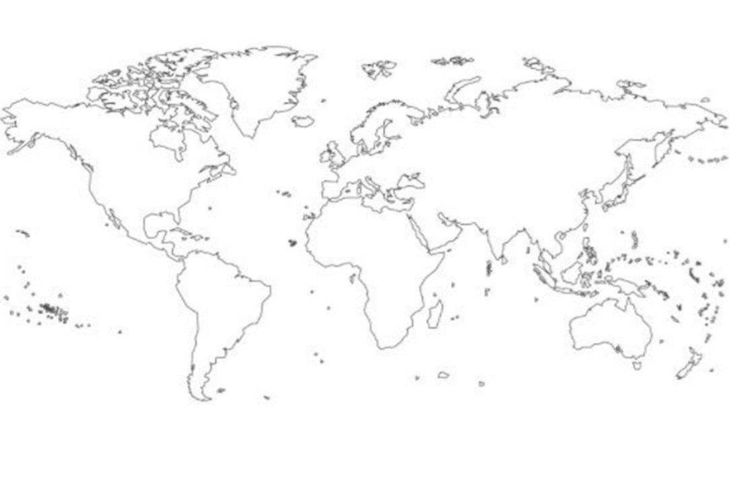
Migration to Britain since c.400AD
Migration to Britain 1900-2010
Use the information you gather on each group to annotate your series of maps showing:
Where in the world groups of migrants came from
Why they came to Britain
Use a different coloured line for each time period.
Don’t forget to label the line for each group!
Pakistani Asians
Caribbean people
East African Asians
www.ourmigrationstory.org.uk

Slide 7
Questions based on your maps
Migration to Britain since c. 400AD
Describe the main patterns of migration in each period. For example, where did migrants come from and in what numbers?
Identify and describe any continuities in migration across and between periods.
Identify and describe any major changes in migration between and across the periods.
Are there any surprises in this information?
What has happened since World War Two to make migration to Britain:
  Change in scale
  Draw in people from many more, and distant, areas of the world?
www.ourmigrationstory.org.uk

